Slide 1
SE - Week 7 PM Review
G7-T5
Kong Yu Jian
Jackson Kwa
Marc Xu
Teh Ming Yi
M Has Nilofar

Slide 2
CONTENT
Functionalities
Schedule (Iterations with Critical Path)
Metrics (Schedule, Pair Programming, Bug)
Roles & Responsibilities
Rotation plan

Slide 3
FUNCTIONALITY
ADDING
View of bids (from the Admin side)
Calender feature (in Student Homepage)
DROPPING
None

Slide 4
MODEL AND FRAMEWORK
MVC model

Slide 5
SCHEDULE
No of iterations : 6
Feature Boxing

Slide 6
ITERATION
Each iteration follows a mini waterfall process:
Design + Planning + Requirement
Coding
Integration
Deployment
Testing & Debugging
Documentation

Slide 7
Iteration 1 (Completed) 01/09/2016 - 18/09/2016 (18 days)
PM: Marc
Tasks:
Understanding requirements and drafting technical documents
Diagramming (Use case, Logical Diagram, Class Diagram, Sequence Diagram)
Wireframing UI
Login and bootstrapping functionality
Milestones accomplished:
NIL
Buffer used and left:
0 used – 5 left
Evaluation:
All tasks were completed on time.

Slide 8
Critical Path For Iteration 1
Project Requirements
1 day
ER + Logical + Class + Sequence Diagram
2 days
Learn new technologies [HTML + CSS + JS + Bootstrap + JSP]
2 days

Slide 9
Creation of SQL schema
1 day
UI Wireframing
1 day
Basic UI skeleton in Twitter Bootstrap
1.5 days

Slide 10
Login functionality UI
1.5 day
Login functionality server-side logic
1 day
Login functionality testing and troubleshooting
1 day
Bootstrapping functionality server-side logic
2 day
Bootstrapping functionality validation
3 day
Bootstrap functionality testing and troubleshooting
1.5 day

Slide 11
18 days in total
Integration of Login and Bootstrap Functionality
2 day
Iteration review, uploading documents & updating critical path
0.5 day
Preparation for Supervisor meeting
0.5 day

Slide 12
Iteration 2 (Completed) 19/09/2016 - 24/09/2016 (6 days)
PM: Jackson
Tasks:
Implement Bid Section function (Student) (Yu jian, Nilofar)
Implement Bid Section function (Admin) (Ming Yi, Marc)
Milestones accomplished:
Supervisor Meeting (19 Sept)
Buffer used and left:
1 day (to catch up on overdue work from the previous iteration)
4 left
Evaluation:
All tasks were completed on time.

Slide 13
Critical Path For Iteration 2
Bidding section functionality Server-side logic [Student]
1 day
Bidding section functionality testing and troubleshooting
1.5 day
Bidding Section functionality UI
1 day
Bidding section functionality Server-side logic [Admin]
2 day
Bidding section functionality testing and troubleshooting
1 day

Slide 14
6 days in total
Bidding section functionality integration
1 day
Prepare documents and presentation for PM Review
1 day

Slide 15
Iteration 3 (in-progress) 26/09/2016 - 02/10/2016 (7 days)
PM: Nilofar
Tasks:
Implement Dropping of Bid (Student) (Yu Jian, Marc)
Implement Viewing / Dropping of Bids (Admin) (Ming Yi, Jackson)
Milestones accomplished:
PM Review (29 Sept)
Buffer used and left:
0 used – 4 left

Slide 16
Critical Path For Iteration 3
View/Drop bid UI [Admin]
1.5 day
View/Drop bid Server-side logic [Admin]
1.5 day
View/Drop bid functionality testing and troubleshooting
1 day
Dropping bid UI [Student]
1 day
Dropping bid Server-side logic [Student]
1 day
Dropping bid functionality testing and troubleshooting
1 day

Slide 17
7 days in total
Drop bid functionality integration
1 day
Functionality testing with test cases & deployment
2 day

Slide 18
Iteration 4 (pending) 03/10/2016 - 15/10/2016 (13 days)
PM: Marc
Tasks:
Implement Clearing Round 1 (Nilofar, Jackson)
Implement Clearing Round 2 (Ming Yi, Yu Jian)
Milestones to accomplish:
In-class demo (13 Oct)

Slide 19
Critical Path For Iteration 4
Clearing round UI
3 day
Clearing round Server-side logic [round 1]
3 day
Clearing round 1 functionality testing and troubleshooting
3 day
Clearing round Server-side logic [round 2]
3 day
Clearing round 2 functionality testing and troubleshooting
2 day

Slide 20
13 days in total
Clearing round functionality integration
2 day
Functionality testing with test cases & deployment
2 day

Slide 21
Iteration 5 (pending) 16/10/2016 - 04/11/2016 (20 days)
PM: Ming Yi
Tasks:
Implement Drop Section function (Student) (Marc, Jackson)
Develop Web Services (Yu Jian, Nilofar)
Final Deployment (Yu Jian, Nilofar)
Milestones to accomplish:
Supervisor Meeting (24 Oct)
UAT (in-class) (3 Nov)

Slide 22
Critical Path For Iteration 5
Dropping section UI
3 day
Dropping section Server-side logic
3 day
Dropping section functionality testing and troubleshooting
3 day
Develop web services [Part 1]
4 day
Develop web services [Part 2]
4 day
Web services functionality testing and troubleshooting
4 day

Slide 23
20 days in total
Integration with all previous functionalities
3 day
AWS deployment & further test case analysis
5 day

Slide 24
Iteration 6 (pending) 05/11/2016 - 18/11/2016 (14 days)
PM: Yu Jian
Tasks:
Ensure documents are uploaded
Cross-check project with requirements
Final Deployment
Final Presentation
Milestones to accomplish:
Final Presentation (17 Nov)
Project Submission (13 Nov)

Slide 25
Critical Path For Iteration 6
14 days in total
Ensure required documents & deliverables uploaded
4 day
Preparation of materials for presentation
5 day
Rehearsals
5 day
FINAL PRESENTATION + SUBMISSION

Slide 26
METRICS (Task, Pair Programming, Bug)

Slide 27
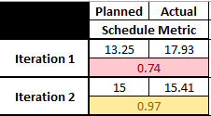
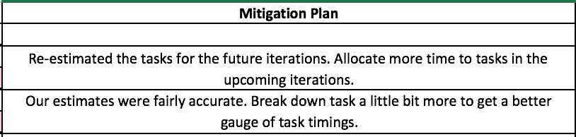
SCHEDULE METRIC

Slide 28
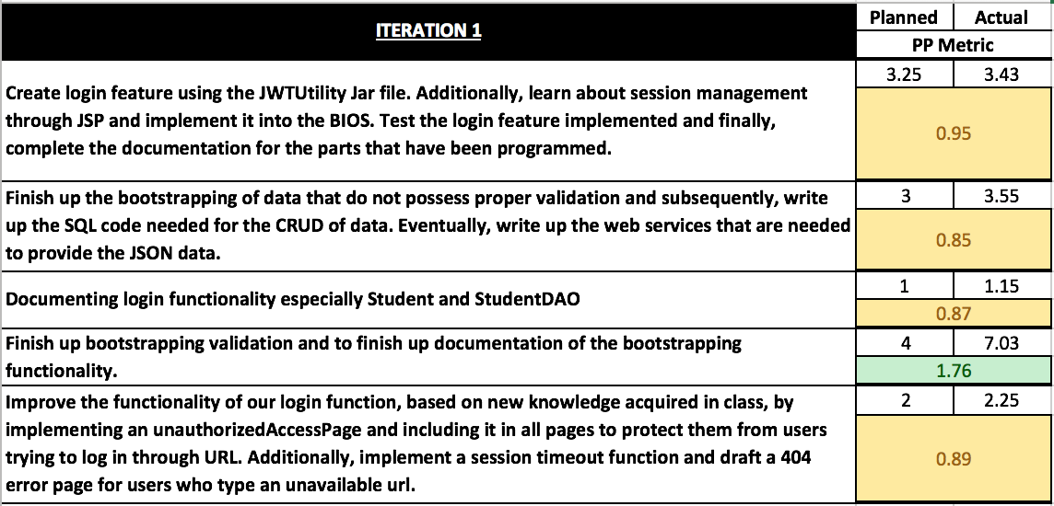
PAIR-PROGRAMMING METRIC (Iteration 1)

Slide 29
PAIR-PROGRAMMING METRIC (Iteration 1)

Slide 30
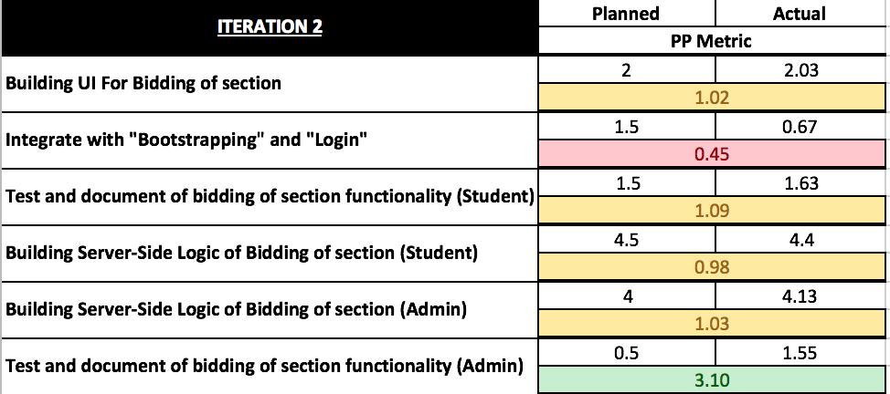
PAIR-PROGRAMMING METRIC (Iteration 2)

Slide 31
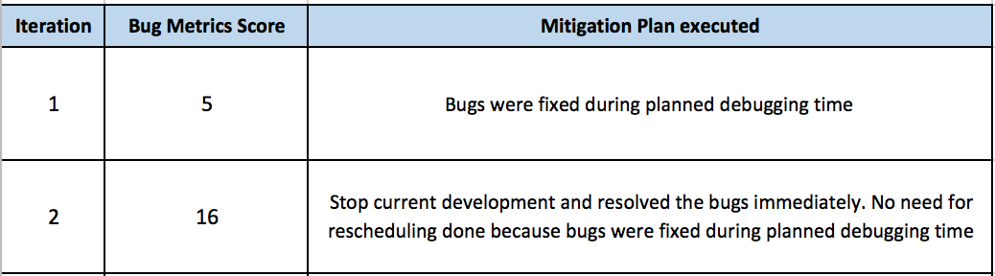
BUG METRIC

Slide 32
MILESTONE IC’S
PM | Managing Period | Milestone
Marc | 1st Sep – 18th Sep | -
Jackson | 19th Sep – 25th Sep | Supervisor Meeting 1
Nilofar | 26th Sep – 2nd Oct | PM Review
Marc | 3rd Oct – 15th Oct | Application In-class demo
Ming Yi | 16th Oct – 4th Nov | Supervisor Meeting 2, UAT
Yu Jian | 5th Nov – 18th Nov | Final Presentation

Slide 33
ROLES & RESPONSIBILITIES
Functionality | Yu Jian | Jackson | Marc | Ming Yi | Nilofar
Bootstrap | √ | √
Login |  |  |  | √ | √
Bidding |  |  | √ |  | √
Clearing Round 1 |  | √ |  |  | √
Clearing Round 2 | √ |  |  | √
Drop Bid |  | √ |  | √
Drop Section | √ |  | √
View Bidding Results | √ |  |  | √

Slide 34
Pair Programming Teams
Iteration | PM | PP1 | PP2
1 | Marc | Ming Yi, Nilofar | Jackson, Yu jian
2 | Jackson | Ming Yi, Marc | Yu Jian, Nilofar
3 | Nilofar | Marc, Yu Jian | Ming Yi, Jackson
4 | Marc | Nilofar, Jackson | Ming Yi, Yu Jian
5 | Ming Yi | Nilofar, Yu Jian | Jackson, Marc
6 | Yu Jian | Nilofar, Marc | Ming Yi, Jackson

Slide 35
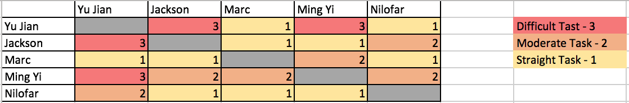
Rotation plan

Slide 36
Thank you

